Slide 1
C# 5
Overview of new features in C# 5
Piotr Mionskowski, Software Engineer
Gdańsk, IT Conference 2012

Slide 2
C# - History overview
C# 1.0 – basic language constructs similar to java (2002)
C# 2.0 – Generics, Iterators, partial types, Anonymous methods, nullable types, method group conversion (2005)
C# 3.0 – Query and Lambda expressions, Expression trees, Extension methods, initializers, implicitely typed local variables (2007)
C# 4.0 – Dynamic, named and optional arguments, generic (co)/(contra)variance, embedded interop types (2010)

Slide 3
C# 5.0 – What’s new
Async
Caller info attributes
Windows Runtime Support
C# 5.0
Notes:
async/await keywords -
Caller info attributes – this is just a taste of what we might get in the future with project Rosylyn and opening of C# compiler
Windows Runtime Support – the new, preferred platform for building native Windows applications (C#/C++/Javascript are first class citizens of WinRT

Slide 4
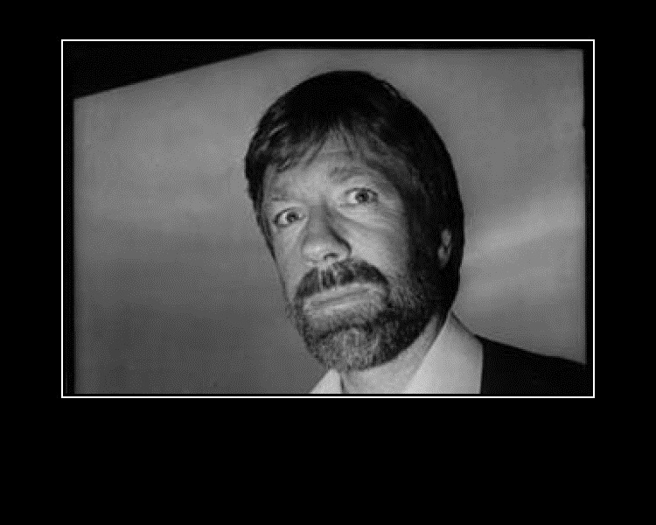
Async
Asynchronous
means hard
Exception handling
Begin/End disturbs control flow
Synchronization context
Resource cleanup – no using statement
TPL and Reactive Extension help
Even he doesn’t
do async
Notes:
It’s really hard to get exception handling right, the exception might happen on begin or end. No `using`, no `finally `
When using traditional Begin/End asynchronous pattern the program control flow is disturbed (splited) which makes understanding of code much harder. This is issue in Javascript too – take a look at jQuery deferred/promise api – that simplify thinks in pretty much the same way that TPL does in .NET.
The callback (End) might (and probably will be) called on different thread than the Begin. The programmer is responsible for maintaining the proper synchronization context (interacting with UI Thread).
TPL provides a unified model of “action” that might take long to complete – the flow of the program is disturbed that much – one has to be careful still to implement async properly – again synchronization contexts, exceptions
Unobserved exception on Task will bring entire app domain down
Reactive extensions on the other hand emphasize the deep releation between asynchronous api and events – in fact many .net api’s support both Begin/End pattern and OnCompleted/OnError events. However the logical program flow is still convoluted – it takes some time to get your head around the brilliant concepts introduced by Rx
Code sample ExceptionHandling

Slide 5
Behold the C# async/await keywords
public async Task<long> GetLength(string address)
{
try
{
var request = WebRequest.CreateHttp(address);
var response = await request.GetResponseAsync();
return response.ContentLength;
}
catch (Exception)
{
return -1;
}
}
Notes:
The control flow is preserved
The compiler generates state machine similar to what we could see when iterator block were introduced (yield)
The implementation allows some extensions to be made – we’ll see that later

Slide 6
Slide Titles are in Title Case Arial 28pt Blue
Bullet points are in sentence case Arial 22pt blue.
Second level bullet points are in sentence case Arial 18pt blue.
Third level bullet points are in sentence case Arial 16pt blue.
Bullet points should be short and concise.
It is recommended that slides should contain no more than 5-8 bulleted items per slide, especially when bullets are longer than one sentence.
Highlighted text is set in Arial Black at the current copy size and should be used only on single words or short phrases.
Quotes should be “the only copy to use italics”

